Slide 1
Understanding of Seasonal change and impact (Monsoon-Flood-Drought)
By
Chowdhury Mujaddid Ahmed

Slide 2
What is seasonal change?
Seasonal changes in precipitation and temperature affect soil moisture, evaporation rates, river flows, lake levels, and snow cover. Leaves fall and plants wither as cold and dry seasons approach.
-Source: NOAA

Slide 3
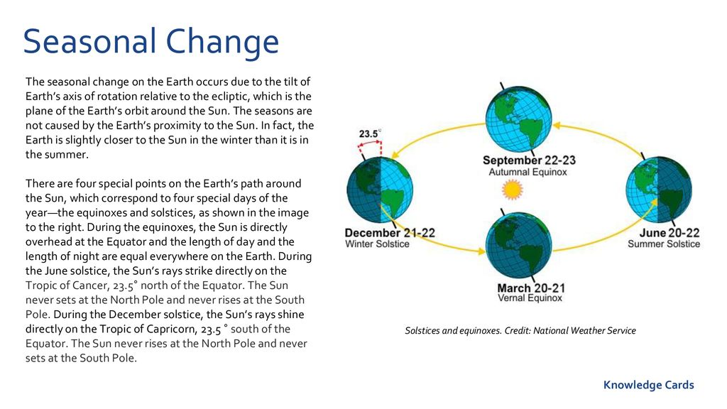
How seasonal change takes place?

Slide 4
Seasons of Bangladesh
Bangladesh is called the land of six seasons (Sadartu).
It has a temperate climate because of its physical location.
Though the climate of Bangladesh is mainly sub-tropical monsoon, ie warm and humid;
the Bangla calendar year is traditionally divided into six seasons: Grisma (summer), Barsa (rainy), Sarat (autumn), Hemanta (late autumn), Shhit (winter) and Basanta (spring).
Each season comprises two months, but some seasons flow into other seasons, while others are short.
In actual, Bangladesh has three distinct seasons: the pre-monsoon hot season from March through May,
the rainy monsoon season which lasts from June through October,
and a cool dry winter season from November through February.
However, March may also be considered as the spring season, and the period from mid-October through mid-November may be called the autumn.

Slide 5
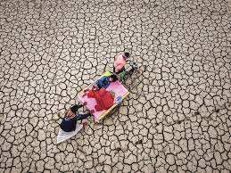
Seasonal Impact
Summer (grisma).
The heat of the sun dries up the waterbodies including rivers, canals, and wetlands. Probability of massive drought compromising food security.
The summer days are longer than the nights.
At this time the southerly or southwesterly monsoons flow over the country.
When dry and cool streams of air flowing from the west and northwest come in contact with wirain-ladenden clouds, storms occur, which, at times, take a violent form.
These storms are popularly known as kalbaishakhi (northwestern) or destructive Baishakh storms.
Summer is a season of fruit baselining of agro-economy

Slide 6
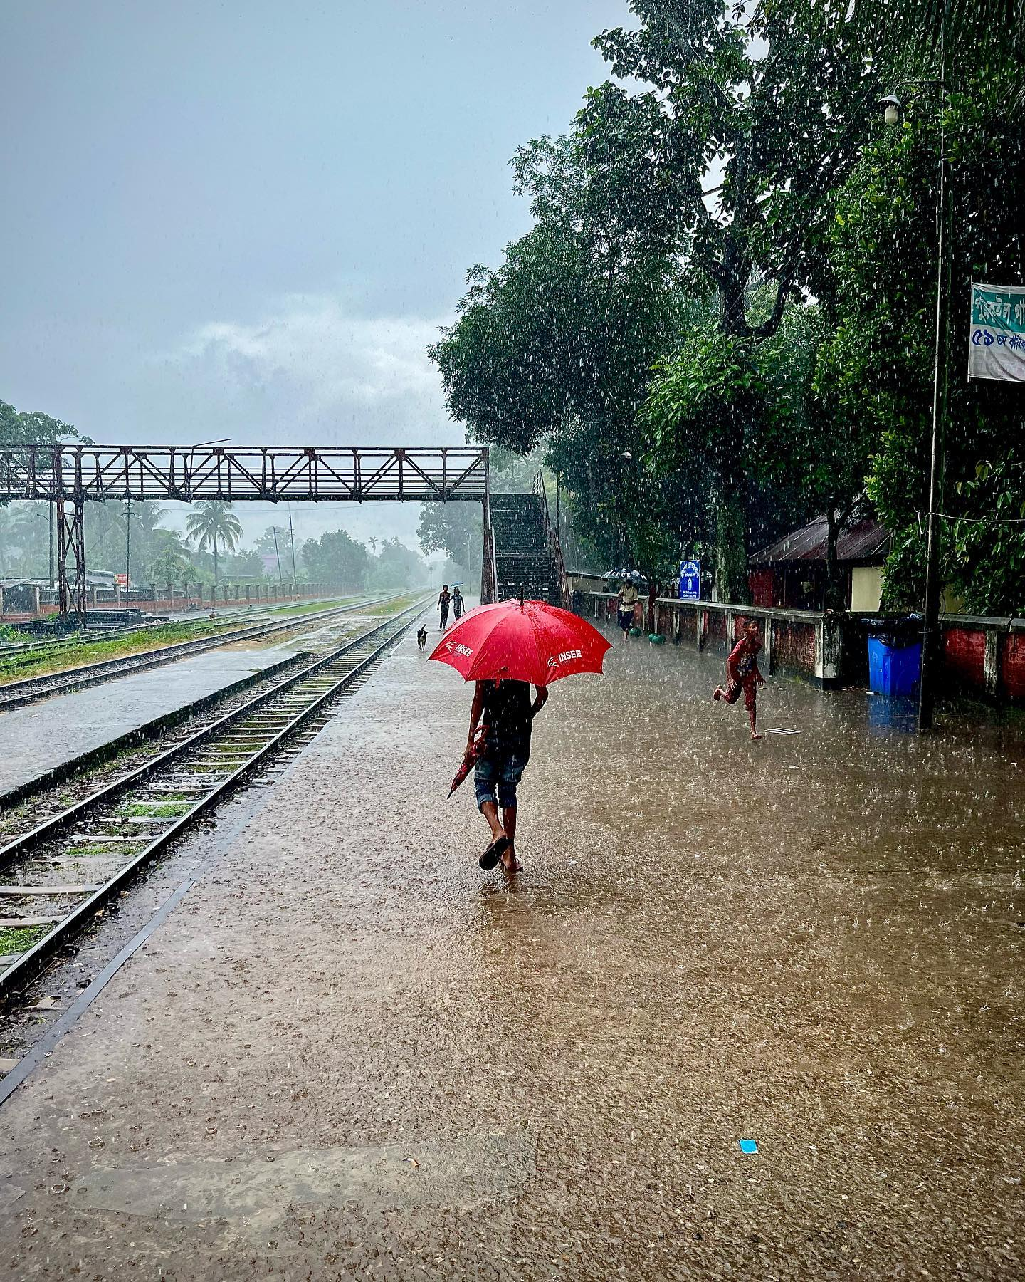
Seasonal Impact
The rainy season (barsa)
During the rainy season, the southwest monsoon winds bring plenty of rainfall (70 to 85 percent of the annual total) and occasionally last for days without end without any respite.
Most of the floodplains of the country remain inundated during this period.
Depending upon the local elevation, the depth and duration of barsha vary in different parts of Bangladesh. For instance, in low-lying parts like haors, beels, and jheels of Sylhet, Netrokona, Kishoreganj, Gopalganj, and Pabna districts inundation lasts for the longest period (more than six months).
In other places, like the central parts of Bangladesh, it lasts for about 3 to 4 months. In rural areas, boat navigation becomes a common mode of transport during this season.
Farmers are busy for harvesting jute, in flood-free areas and/or shallowly flooded (0 to 30 cm depth) areas for preparing paddy seedbeds.
Barsha is also important for the fishing community of Bangladesh. hilsa fish is available in plenty during this season.
The inundated floodplains become a large habitat for a wide variety of aquatic flora and fauna. At this time plenty of edible herbs grow everywhere, as does the national flower lotus.
This is the season for keya, kadam, kamini, jui, gandharaj and other fragrant flowers, as well as fruits like guava, pineapple, and pomelo.

Slide 7
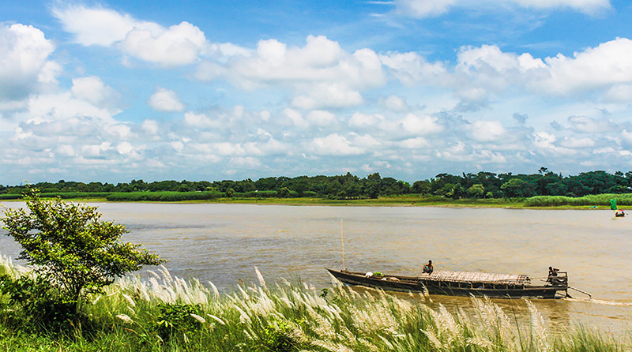
Seasonal Impact
Autumn (sharat)
The dark clouds in a grey sky, characteristic of the rainy season, are replaced by white clouds floating in a blue sky. Though at the beginning of this season, the days can be hot and sultry, towards the end of the season the nights and mornings become cool.
The gradual decrease in humidity also makes the weather comfortable.
During autumn a large number of fragrant flowers blossom: shiuli, roses, bakul, mallika, kamini and madhabi. The lotus grows in the wetlands and kash flower on the riverfronts.
This is also the time when the palmyra ripens. A major Hindu festival durga puja is celebrated during this season.

Slide 8
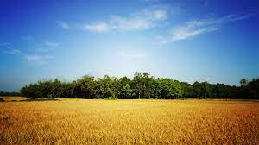
Seasonal Impact
Late autumn (hemanta)
It is a transitional phase between autumn and winter.
By mid-November the evenings grow cool.
The contrast between the daytime and nighttime temperatures results in heavy dew.
This is also the time for colds, coughs, and fevers.
In this season farmers are very busy with harvesting paddy and celebrating navanna with the new rice crop.

Slide 9
Seasonal Impact
Winter
The Winter: Average temperatures in January vary from about 11'C in the northwestern and northeastern parts of the country to 20'C to 21'C in the coastal areas.
Northern Bangladesh is cooler than southern Bangladesh, with occasional cold spells that claim lives. During this season, a center of high pressure lies over the northwestern part of India (Himalayan zone). A stream of cold air flows eastward from this high pressure and enters Bangladesh through its northwest corner. During this season, winds inside Bangladesh generally have a northerly component (ie, flowing from north or northwest).
The winter season is very dry, which accounts for less than 4 percent of the total annual rainfall. Average rainfall during the season varies from less than 2 cm in the west and south to slightly over 4 cm in the northeast.
Rainfall in this season is caused by the wind coming from the Mediterranean region that enters the country from the northwestern part of India along the Ganges basin.
Rainfall amount is slightly enhanced in northeastern Bangladesh by the orographic effect of the Meghalaya Plateau. These rainy spells bring the temperature down. The nights are longer than the days and mornings are often foggy. This is the time when deciduous trees shed their leaves.
Winter is the best and most enjoyable season of Bangladesh. A large variety of vegetables are available in the markets. So is fish, particularly large koi, magur, shing.
Special flowers of the season are Ganda and Suryamukhi. Boroi (jujube) and oranges are among the fruits of this season. Date juice is extracted during this time, to be used as juice or made into gud (molasses). This is the season for pitha or rice cakes such as bhapa pitha, chitai pitha, patisapta and puli pitha.

Slide 10
Seasonal Impact
The spring (basanta)
Weather is normally pleasant, with 20 to 25 percent cloud-cover, comfortable temperature and moderate relative humidity.
The average temperature in March varies from 22'C to 25'C all over the country, with relative humidity ranging from 50 to 70 percent. However, temperature, cloud cover and relative humidity during the early part of the season are lower than their respective average values. Occasionally, isolated thunderstorms may occur in the afternoon, especially during the second half of March.
Spring is called the king of seasons.
At this time the sky is clear and plants sprout new leaves. There are balmy breezes from the south, very welcome after the cold winter.
Flame-colored shimul, palash and krisnachuda blossom, as does the golden radhachuda and the mauve jarul.
Fruit trees such as mango and jackfruit also flower at this time. Spring sees the advent of the cuckoo, which sings hidden in the foliage. This is also the season for bees to become active gathering nectar.
Wheat, oat and mustard dominate the fields. Hindus celebrate pujas like Basanti and doljatra. In the past this season' was marked by epidemics like cholera and smallpox (which was called basanta). Smallpox has since been completely eradicated and cholera largely controlled.

Slide 11
Thank you
End of Lecture 5

